Slide 1
LLM-Driven Synthetic Data Generation for API Testing
Raguraman T
2023AA05528
BITS Pilani

Slide 2
Problem Statement
Manual test data generation
Time-consuming
Error-prone
Schema complex
Risky with PHI/PII data

Slide 3
Objective
Build an LLM-based tool:
Uses data schema as context. Ex, Json-schema, Open Api specification
Accepts natural language prompts
Generates accurate, schema-compliant test data

Slide 4
Proposed Solution
Use LLMs to understand:
Schema structure
User prompts
Generate test data through:
Prompt engineering
Context-aware synthesis

Slide 5
Implementation Overview
Data:
Hand crafted
De-identified production data
Model layer:
LLM-based prompt processing
Fine tuning if needed to achieve domain specific data generation
Interface:
API + Chat UI for user interaction
API + System integration

Slide 6
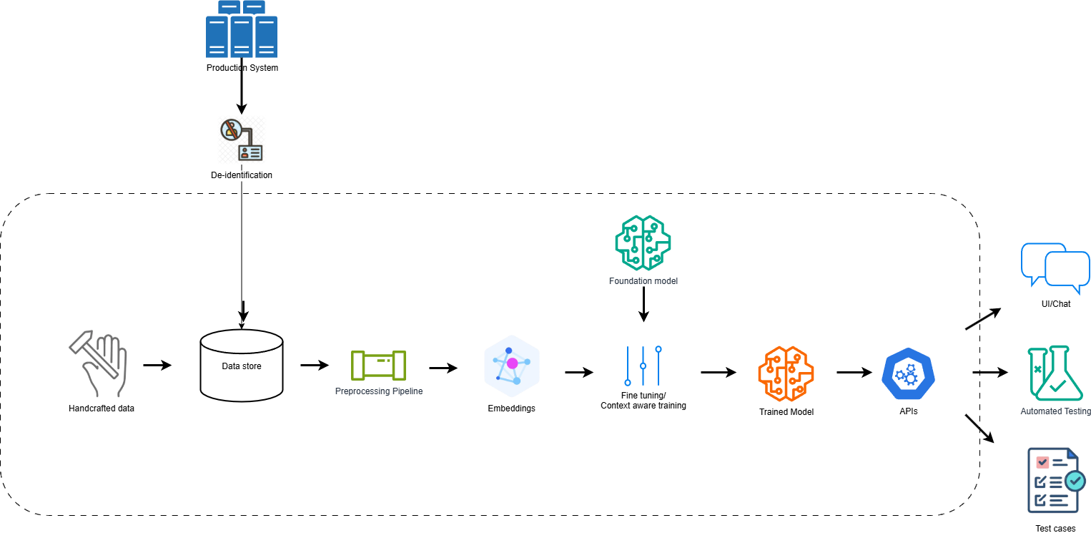
Implementation Overview

Slide 7
Benefits
Fast and customizable data creation
Less reliance on technical expertise
No sensitive data leakage
Seamless integration with DevOps tools, API Market places, etc.
Can be extended to automated test generation tools

Slide 8
Project Timeline
Week 1–2: Research and Planning
Week 3–4: LLM Model Selection (In-Progress)
Week 5–6: Data Preparation
Week 7–11: Implementation
Week 12–13: Evaluation
Week 14: Deployment
Week 15: Documentation

Slide 9
Paper Reference
Context-aware Automated Text Input Generation for Mobile GUI Testing https://arxiv.org/pdf/2212.04732
On LLMs-Driven Synthetic Data Generation, Curation, and Evaluation: A Survey https://aclanthology.org/2024.findings-acl.658.pdf
Large Language Models for JSON Schema Discovery https://arxiv.org/pdf/2407.03286
A Case Study in LLM Driven Test Data Generation https://ieeexplore.ieee.org/document/10589904

